Slide 1
Depreciation
Unit 3

Slide 2
Meaning of Depreciation
Depreciation can be defined as a continuing, permanent and gradual decrease in the book value of fixed assets. This type of shrinkage is based on the cost of assets utilized in a firm and not on its market value.
In Accounts, Depreciation can be defined as the method of allocating the cost of a physical asset over its useful life or the time period it is to be used for. In simple words, depreciation is the reduction in the value of an asset due to the passage of time, normal wear and tear and obsolescence. Depreciation is generally regarded as a non-cash expenditure and helps companies to reduce their taxable income.

Slide 3
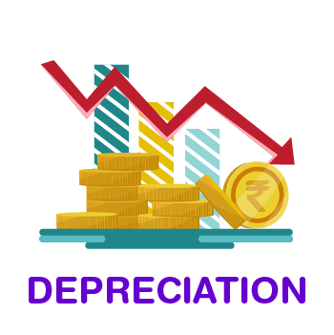

Slide 4
Features of Depreciation
Following are the 3 principal features of depreciation:
Depreciation is a decrease in the book value of fixed assets.
Depreciation involves loss of value of assets due to the passage of time and obsolescence.
Depreciation is an ongoing process until the end of the life of assets

Slide 5
Causes of Depreciation
Wear and Tear due to Use or Passage of Time: Wear and tear is nothing but deterioration and the following decrease in the value of an asset, resulting from its use in business operations for earning revenue.
Expiration of Legal Rights: Some categories of assets lose their value after the agreement directing their use in business comes to an end after the expiry of the predetermined period.
Obsolescence: Obsolescence is another factor driving to the depreciation of fixed assets. In common language, obsolescence means being “out-of-date”. Obsolescence refers to an actual asset becoming outdated on account of the availability of a better type of asset.
Abnormal Factors: Drop in the use of the asset may be caused by abnormal factors. Namely, accidents due to the earthquake, fire, floods, etc., Accidental loss is permanent but not continuing.

Slide 6
Methods of Calculating Depreciation
In Accounting, there are various methods for calculating depreciation. A company can adopt any of these methods of calculating depreciation depending on its needs. Some of the methods for calculating depreciation are:
Straight-line method
Written down Value method
Annuity method
Sinking Fund method
Production Unit method

Slide 7
Straight Line Method (SLM)
Under the depreciation Straight Line Method, a fixed depreciation amount is charged annually, during the lifetime of an asset. The amount of annual depreciation is computed on Original Cost and it remains fixed from year to year. This method is also known as the ‘Original Cost method’ or ‘Fixed Instalment method’.

Slide 8
The straight-line method of depreciation is the most simple and easy to use depreciation method. It is the most commonly used method of depreciation. It is also called the Original cost method, Fixed Installment method or Equal Installment method.
Under this method, the depreciation calculation is done by deducting the residual value from the Cost of the asset and then the amount is divided by the number of years the asset was used for or its useful life.
The same amount of depreciation is charged every year on the original cost of the asset. The amount of depreciation is charged to the Profit and Loss Account every year.

Slide 9
Depreciation Formula: Cost of Asset - Residual Value/Useful life of the asset
Depreciation Rate Formula: Amount of Depreciation/Original Cost of the Asset X 100
Straight-line Method Formula is:

Slide 10
Written Down Value Method (WDV)
Under the Written Down Value method, depreciation is charged on the book value (cost –depreciation) of the asset every year. Under the WDV method, book value keeps on reducing so, annual depreciation also keeps on decreasing. This method is also known as ‘Diminishing Balance Method’ or ‘Reducing Instalment Method’.

